Slide 1
Welcome to English Class7
Unit 11: SCIENCE AND TECHNOLOGY
(A CLOSER LOOK1)
Let’s learn English !

Slide 2
Unit 11: SCIENCE AND TECHNOLOGY – A Close look 1
.
Vocabulary:
+ Look out!
- We add -er, -or, or -ist to a verb or noun to form a noun indicating people.
Example:
to learn → learner
- to invent → inventor
- Science → scientist

Slide 3
Unit 11: SCIENCE AND TECHNOLOGY – A Close look 1
Vocabulary:
1. Complete the following sentences with nouns indicating people.
adviser
1. A person who gives advice is an _______.
2. A scientist who studies chemistry is a _______.
3. A person whose job is to design things is a _______.
4. A person whose job is writing programmes for computers is a _______.
5. A marine _______ is a scientist who studies
chemist
designer
programmer
biologist

Slide 4
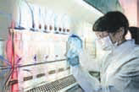
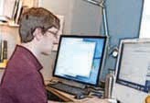
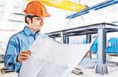
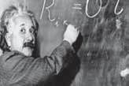
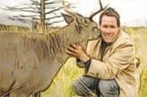
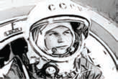
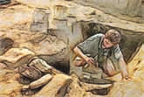
Unit 11: SCIENCE AND TECHNOLOGY – A Close look 1
2. Write a noun from the list under each picture
doctor chemist physicist archeologist explorer engineer software developer conservationist
Who’s this?
chemist
software developer-
engineer
physicist
doctor
conservationist
explorer
archeologist

Slide 5
Unit 11: SCIENCE AND TECHNOLOGY – A Close look 1
3. Give the correct form of the words in brackets.
development
1. Every day we hear about new (develop) ______ in science and technology.
2. Einstein was one of the greatest (science) ______ in the world.
3. The USA is a world leader in space (explore) ______ .
4. Advances in (medicine) ______ science will help people live longer in the future.
5. There is a link between (economy) ___________ development and the environment.
scientist
explorer
medical
economic

Slide 6
Unit 11: SCIENCE AND TECHNOLOGY – A Close look 1
Pronunciation
Stress in words starting with un- and im-
- When we add the prefix un- or im- (meaning ‘not’) to a root word, the stress of the word does not normally change.
Example:
- 'friendly → un'friendly
- 'probable → im'probable
Note: When we add the prefix un- or im- to a one-syllable word, the stress falls on the root word.
Example:
- fair → un'fair
- pure → im'pure

Slide 7
Unit 11: SCIENCE AND TECHNOLOGY – A Close look 1
4. Listen and repeat the following words.
Mark the stressed syllables in the words.
unforeseen unlucky
immature unwise
impatient unhealthy
impure unhurt
impossible unlimited
Unnatural impolite

Slide 8
Unit 11: SCIENCE AND TECHNOLOGY – A Close look 1
5. Put the words from 4 in the right columns.
oO | oOo | ooO | oOoo
unwise
unlucky
impolite
impossible

Slide 9
Unit 11: SCIENCE AND TECHNOLOGY – A Close look 1
6. Fill the gaps with one of the words in 5.
Listen and check, then read the sentences
1. The teacher said this water was ______ and couldn’t be used in our experiment.
2. Scientists have identified a link between an ______ diet and diseases.
3. This job would be ______ without the help of a computer.
4. Our natural resources are not ______.
5. It’s no good being ______ with small children.
impure
unhealthy
impossible
unlimited
impatient

Slide 10
Unit 11: SCIENCE AND TECHNOLOGY – A Close look 1
* Homework:
- Learn vocabulary by heart and rewrite them in sentences.
- Redo the exercise in your notebook.
- Prepare for a closer look 2

